Slide 1


Developed by Aerosmith Team

Slide 2
Aerosmith Messenger Structure
MS SQL Server
Clients
1
Angular 4 SPA
Server
2
1
Android App
API
Web API
3
WebSockets
2
WPF App
SignalR Hub

Slide 3

Show me your Server side
Notes:
Show me your Dark side

Slide 4
Server Side
Technologies:
EntityFramework (6.1.3) – ORM for DB
Microsoft.AspNet.WebApi (5.2.3) – API
Microsoft.AspNet.SignalR (2.2.2) – WebSockets for messaging
System.IdentityModel.Tokens.Jwt (5.1.3) –JWT Authentication
Unity.WebAPI (5.2.3) – IoC Container
AutoMapper (6.0.2) – Convert from/to DTO
Patterns:
Repository and Unit of Work
Inversion of Control

Slide 5
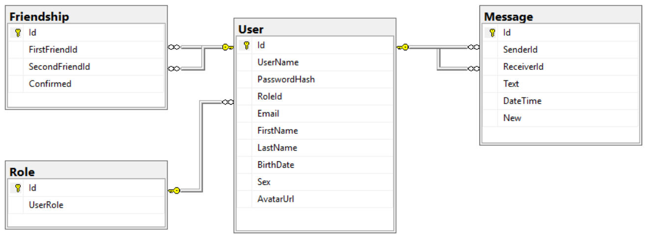
MS SQL Server Database Structure

Slide 6
Server Structure
IIS
JWT Authentication Filter
Controllers
UnitOfWork
EntityFramework & Database
Authorization
UserRepository
Services (Shortest Path, Password Encoder, Pagination etc)
Users
FriendshipRepository
Friends
MessageRepository
MessageHub
DB Context
Data Transfer Models

Slide 7
Server Side
JWT Authentication, SignIn/SignUp.
Change userinfo, username and password, upload avatar, delete user.
Search users, send friendship requests and confirmation of requests, get friends and requests, get mutual friends, check if 2 users are friends and if friendship request already exists, delete friendship.

Slide 8
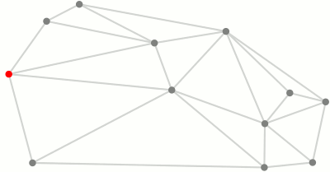
Dijkstra algorithm

Slide 9
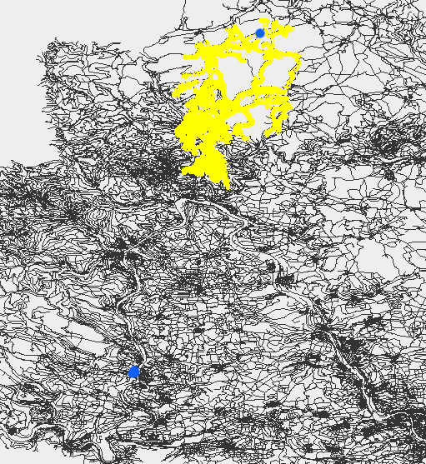
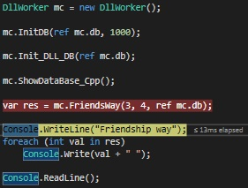
Dijkstra algorithm

Slide 10
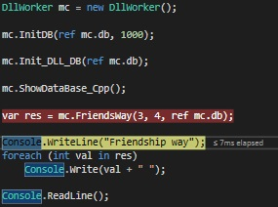
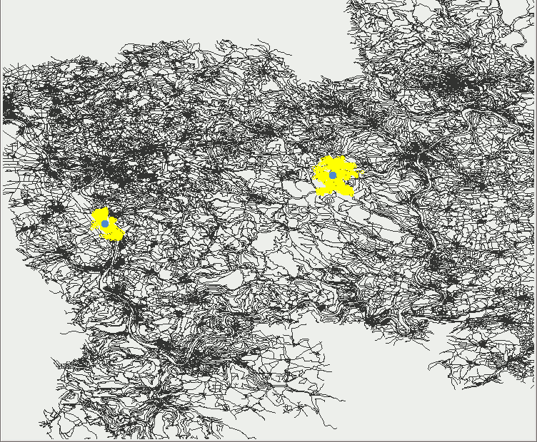
Acceleration of the Dijkstra algorithm

Slide 11
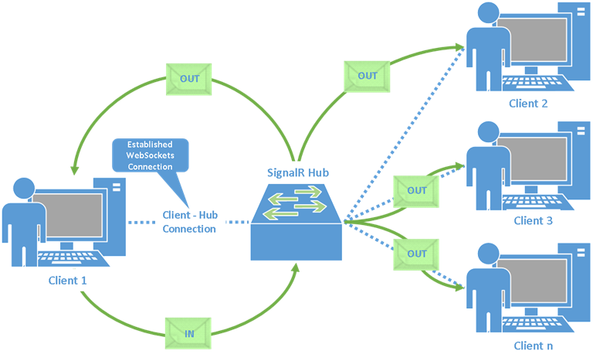
SignalR Messaging
Check if user online
Get Correspondence and Conversations
Send and Remove
Message
Check if user
typing
Get new
messages

Slide 12

Front-End you must have
Notes:
Patience you must have

Slide 13

Front-End Side
Ability to Send and Remove Messages
Conversations List
Active correspondence
Check if user online
Check if user typing
Notification about new messages
Technologies:
Angular 4.2.4
Angular/Material 2.0.0-beta.7
SignalR 2.2.2
Material-design-icons 3.0.1
Rxjs 5.4.1 and etc.

Slide 14

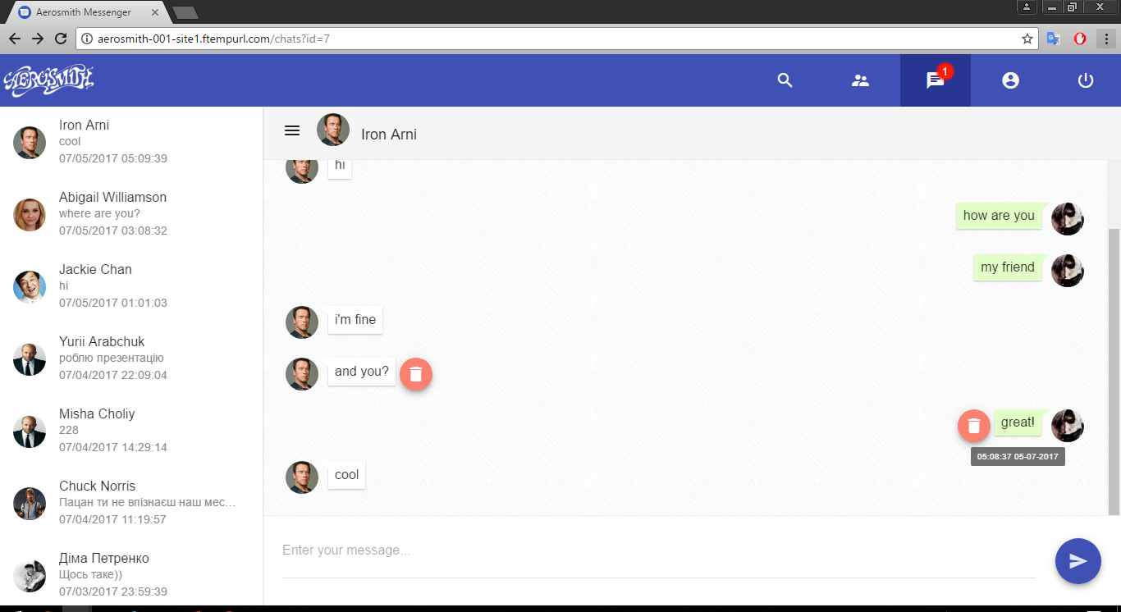
Front-End Side

Slide 15
Front-End Side
SignIn/SignUp.
Change userinfo, username and password, upload avatar, delete user.
Search users, send friendship requests and confirmation of requests, delete friend.
List of friends and requests.
User profile with mutual friends and shortest path.
Technologies:
Angular 4.2.4
Angular/Material 2.0.0-beta.7
SignalR 2.2.2
Material-design-icons 3.0.1
Rxjs 5.4.1 and etc.

Slide 16
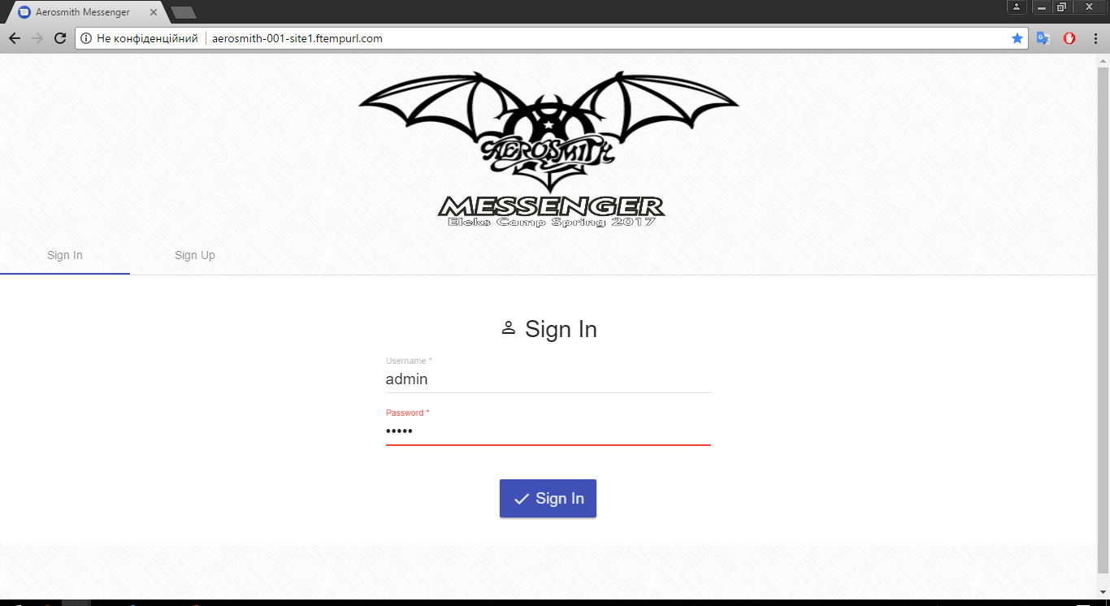
Front-End Side

Slide 17
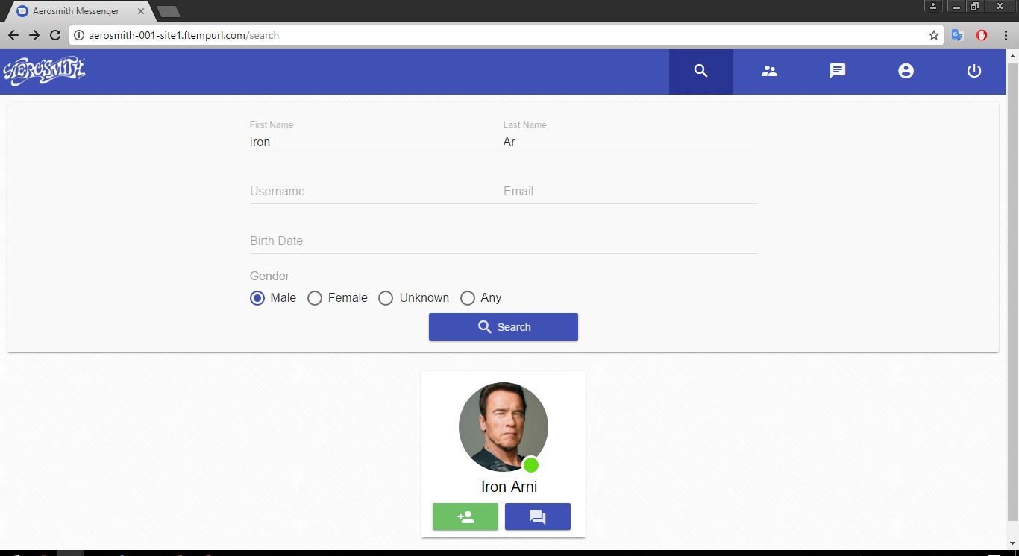
Front-End Side

Slide 18
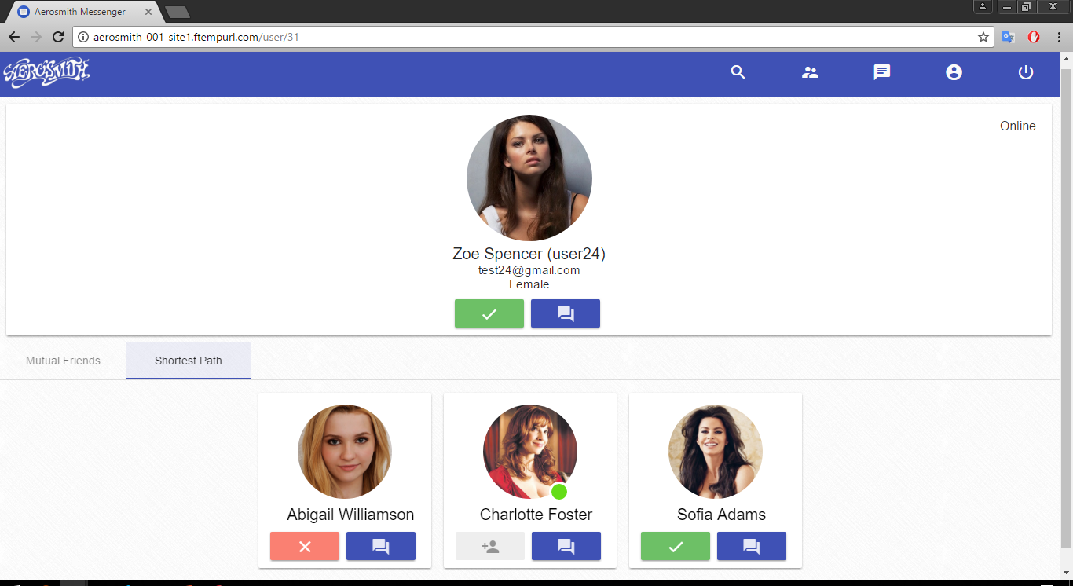
Front-End Side

Slide 19
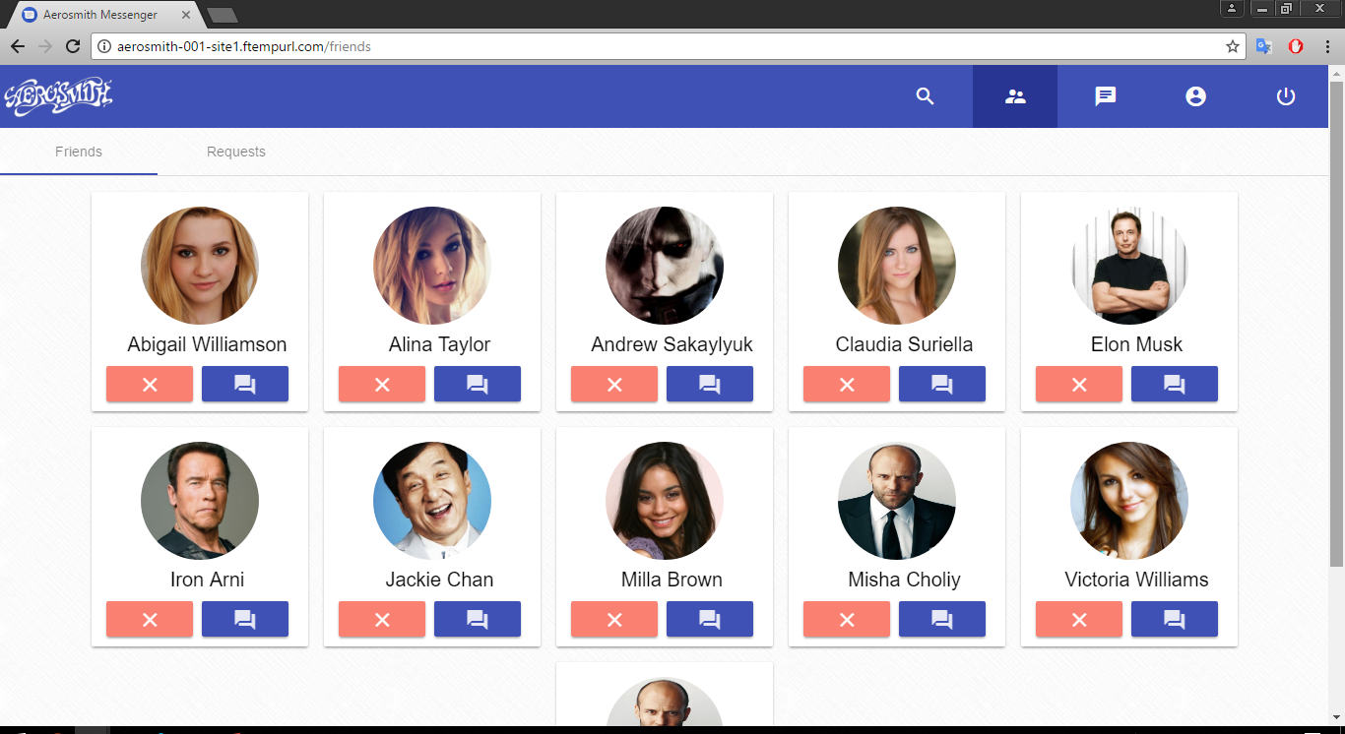
Front-End Side

Slide 20
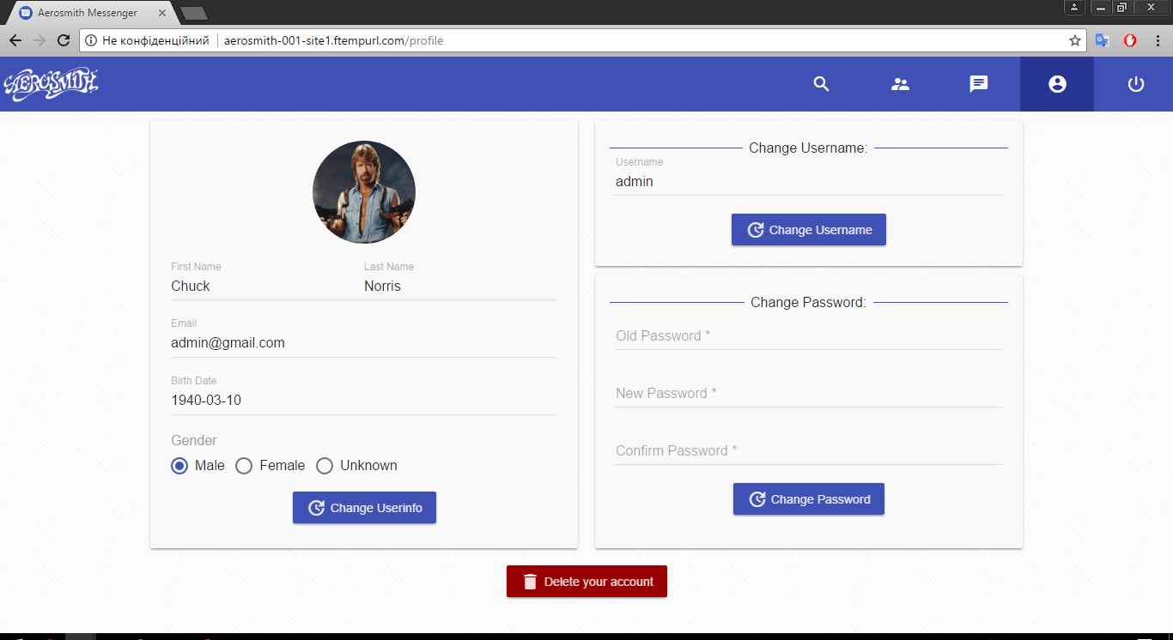
Front-End Side

Slide 21

Excuse me sir, but that Android
is in prime condition
Notes:
Excuse me sir, but that R2-D2 is in prime condition

Slide 22
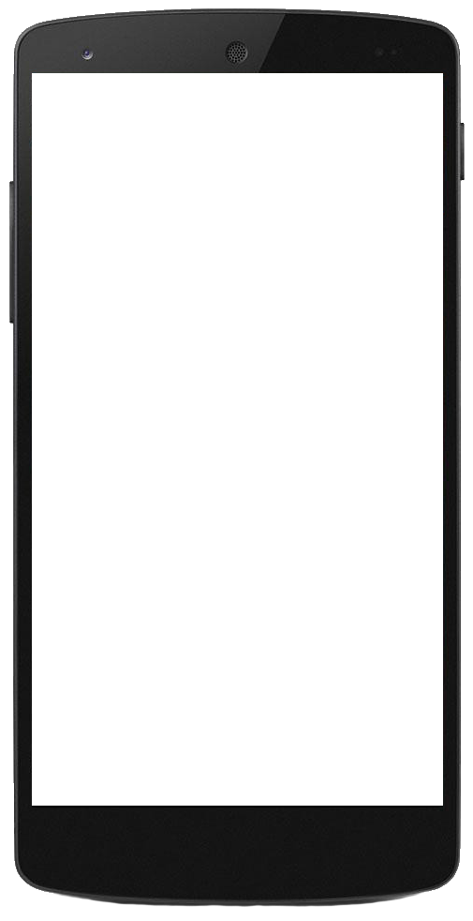
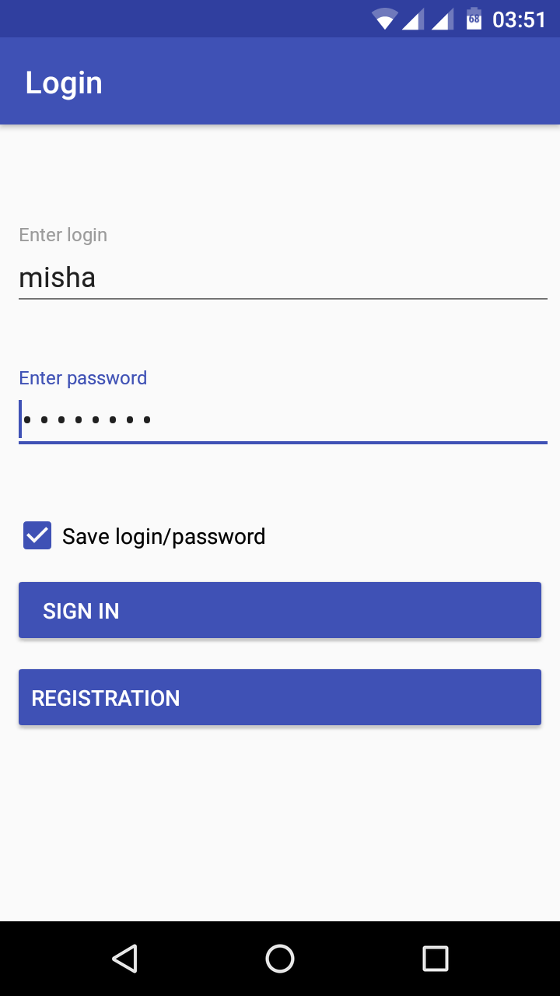
Android Client
SignIn/SignUp.
Change userinfo and password, upload avatar, delete user.
Search users, send friendship requests and confirmation requests, delete friends.
Messaging with friends.
Mutual friends and shortest path to user lists.

Slide 23
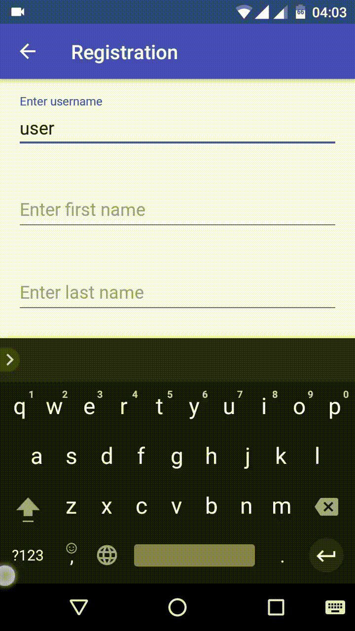
Android Client
SignIn/SignUp.
Change userinfo and password, upload avatar, delete user.
Search users, send friendship requests and requests confirmation, delete friends.
Messaging with friends.
Mutual friends and shortest path to user lists.

Slide 24
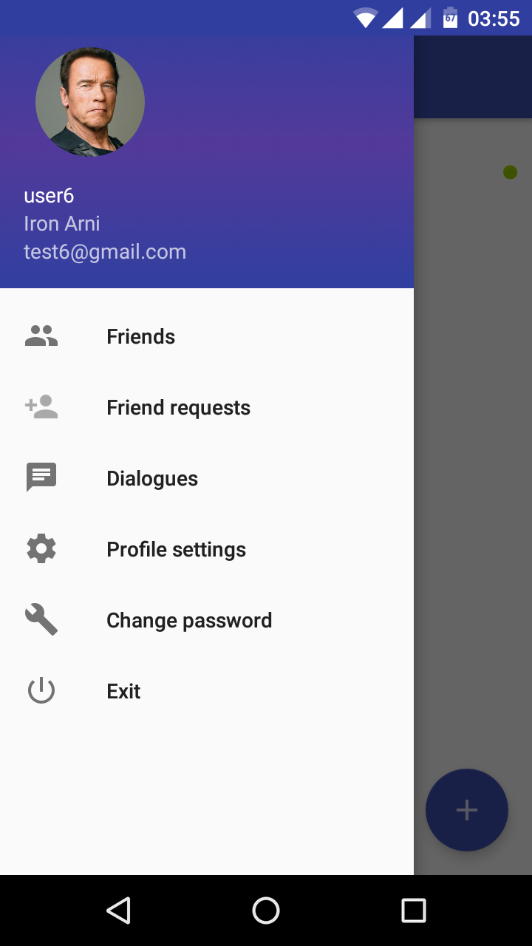
Android Client
SignIn/SignUp.
Change userinfo and password, upload avatar, delete user.
Search users, send friendship requests and requests confirmation, delete friends.
Messaging with friends.
Mutual friends and shortest path to user lists.

Slide 25
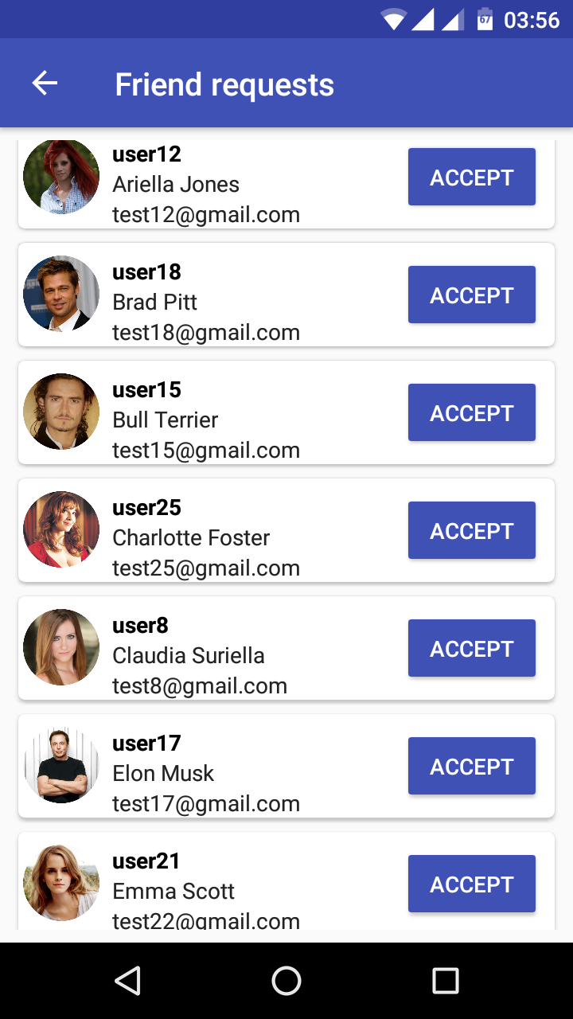
Android Client
SignIn/SignUp.
Change userinfo and password, upload avatar, delete user.
Search users, send friendship requests and requests confirmation, delete friends.
Messaging with friends.
Mutual friends and shortest path to user lists.

Slide 26
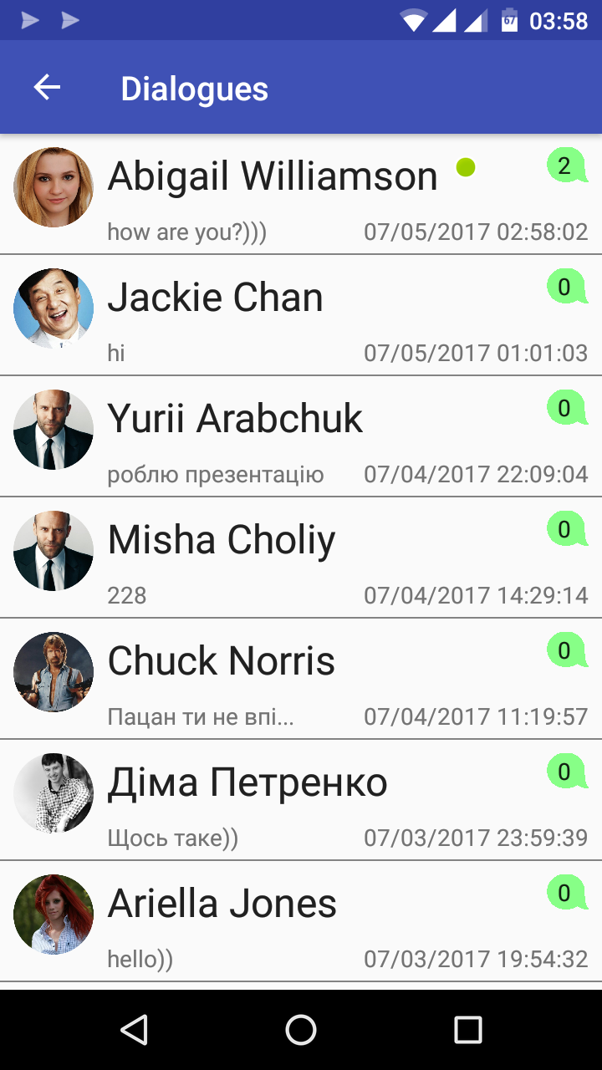
Android Client
SignIn/SignUp.
Change userinfo and password, upload avatar, delete user.
Search users, send friendship requests and requests confirmation, delete friends.
Messaging with friends.
Mutual friends and shortest path to user lists.

Slide 27
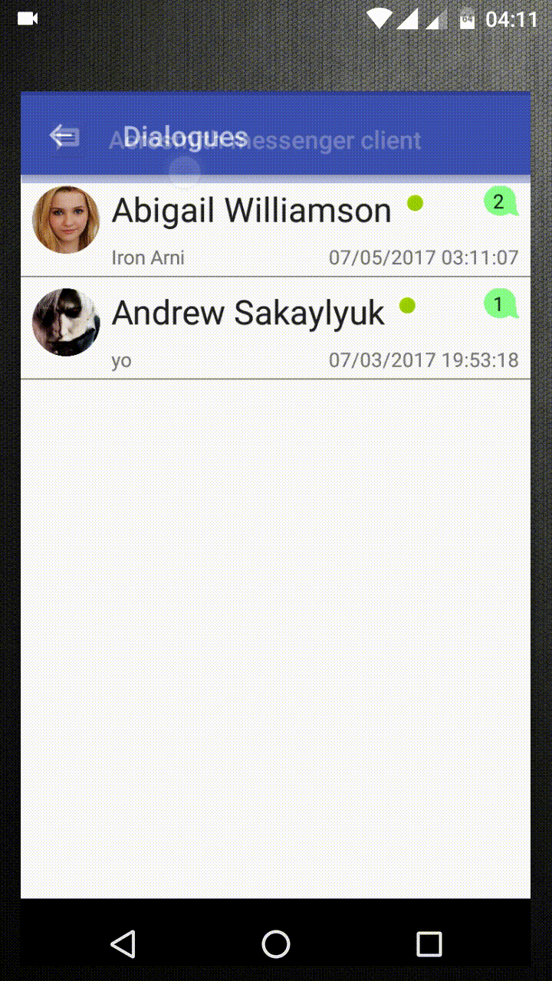
Android Client
SignIn/SignUp.
Change userinfo and password, upload avatar, delete user.
Search users, send friendship requests and requests confirmation, delete friends.
Messaging with friends.
Mutual friends and shortest path to user lists.

Slide 28
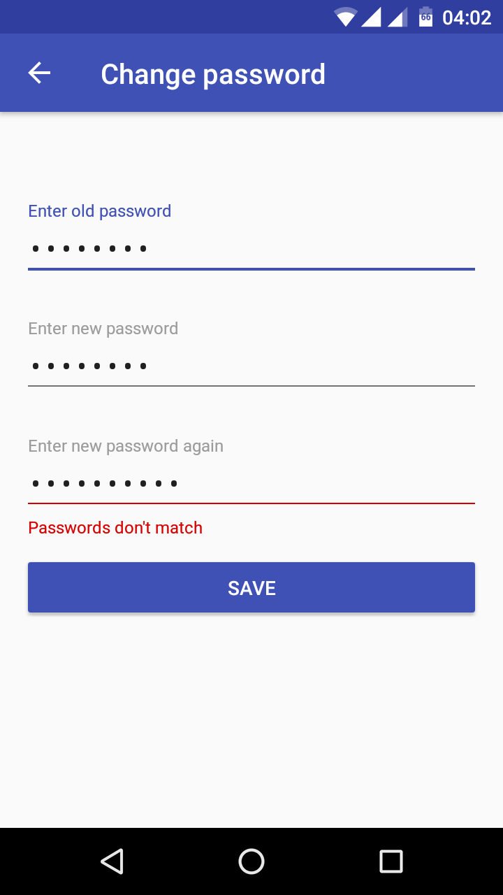
Android Client
SignIn/SignUp.
Change userinfo and password, upload avatar, delete user.
Search users, send friendship requests and requests confirmation, delete friends.
Messaging with friends.
Mutual friends and shortest path to user lists.

Slide 29
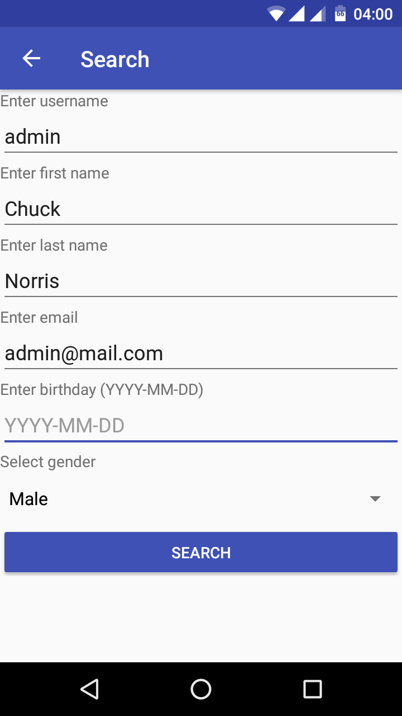
Android Client
SignIn/SignUp.
Change userinfo and password, upload avatar, delete user.
Search users, send friendship requests and requests confirmation, delete friends.
Messaging with friends.
Mutual friends and shortest path to user lists.

Slide 30
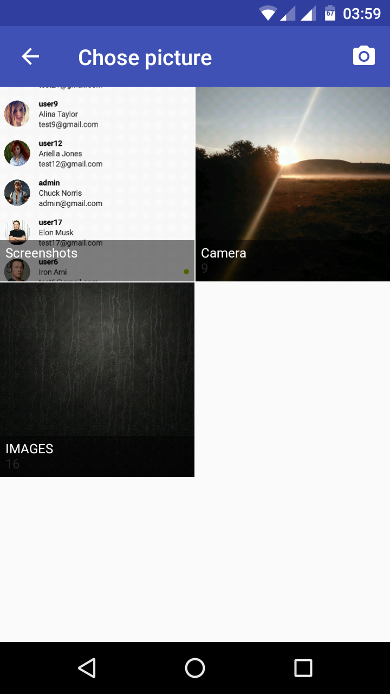
Android Client
SignIn/SignUp.
Change userinfo and password, upload avatar, delete user.
Search users, send friendship requests and requests confirmation, delete friends.
Messaging with friends.
Mutual friends and shortest path to user lists.

Slide 31
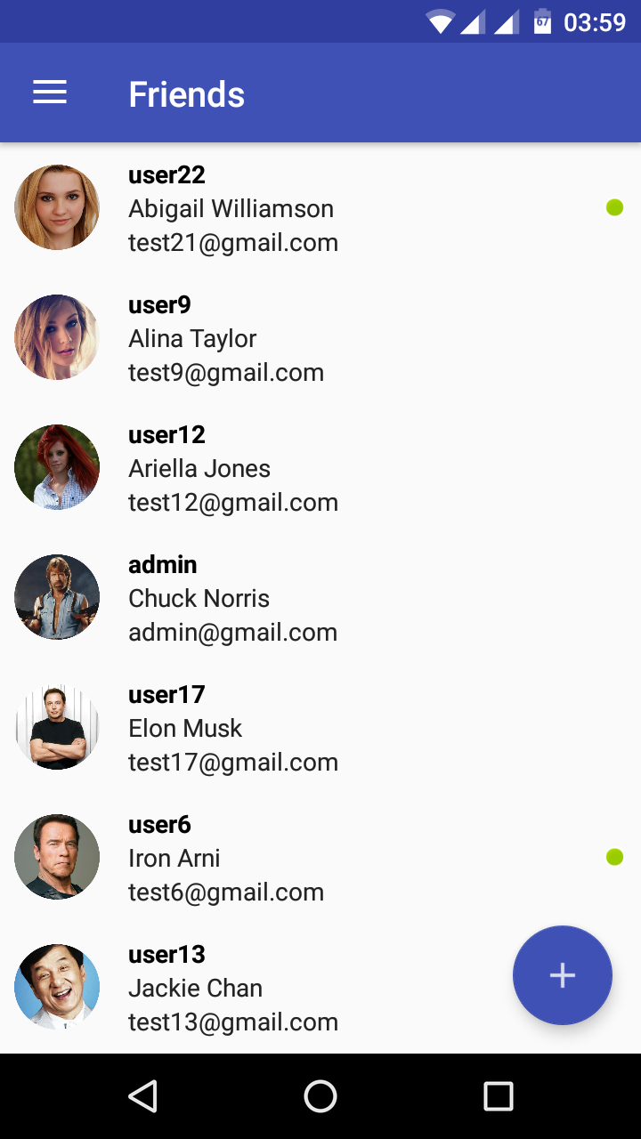
Android Client
SignIn/SignUp.
Change userinfo and password, upload avatar, delete user.
Search users, send friendship requests and requests confirmation, delete friends.
Messaging with friends.
Mutual friends and shortest path to user lists.

Slide 32
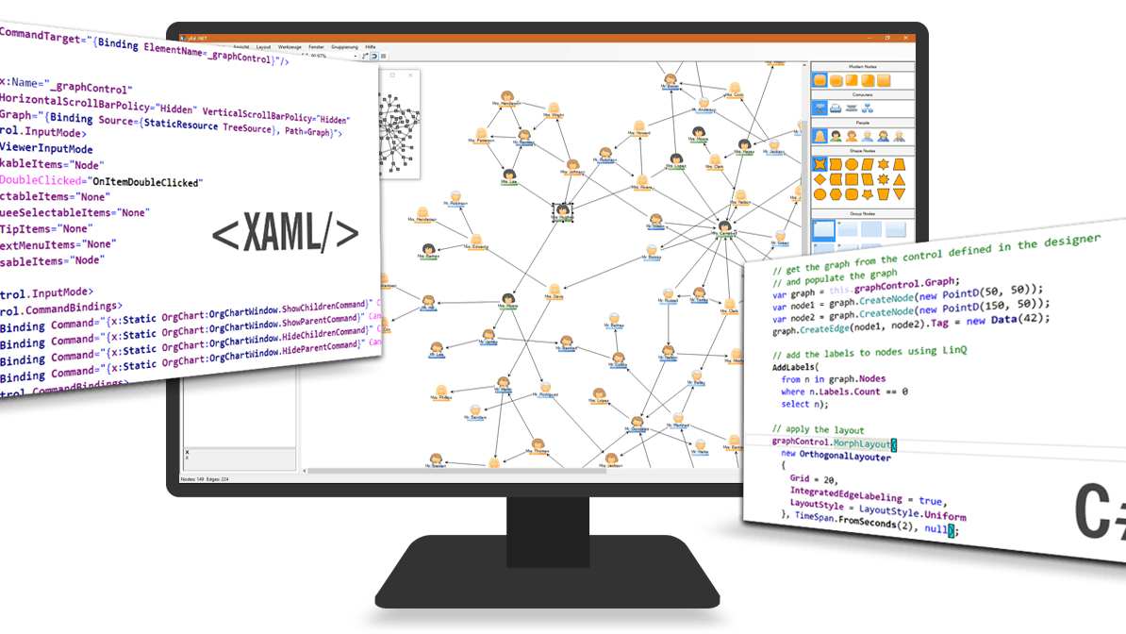

Desktop Messenger Client

Slide 33

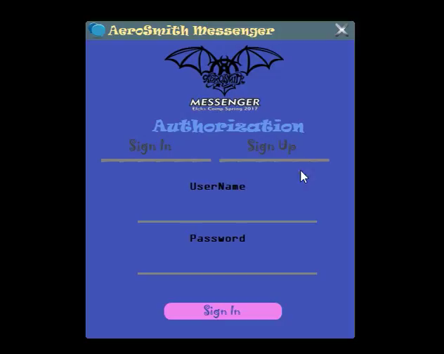
WPF Client

Slide 34
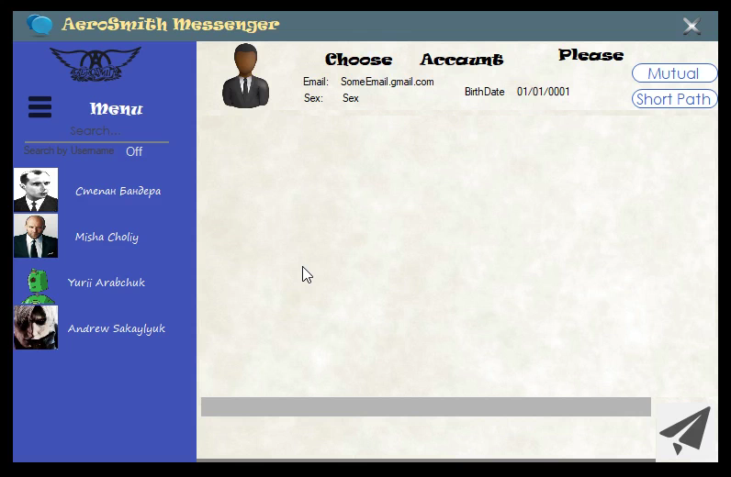
WPF Client

Slide 35

Now this is not the end. It is not even the beginning of the end. But it is, perhaps, the end of the beginning.
© Winston Churchill

Slide 36

That’s all.
Really)
Thanks for watching.
Best regards, Aerosmith Team.
Fork us on GitLab

